Slide 1
The Evolving Role of Crop Insurance in Farm Risk Management
Keith Collins, NCIS
AAEA Crop Insurance Symposium
October 8, 2013
Louisville, KY

Slide 2
Agenda
Evolution
Participation metrics:
Farm
Company
Taxpayer/government
Issues

Slide 3
Early Years
Concept of “Spreading risk” goes far back
First crop insurance, hail in 1880
First MPCI policy in 1899, Minneapolis fire insurance company for wheat
Varied approaches tried, e.g., cost of production, Hartford Fire Insurance Company in 1920 & 1921

Slide 4
Senate Interest, 1922
U.S. Senate, McNary Resolution created a Select Committee to study crop insurance
NY Times’ editorial, 9/22/22:
“There was a good deal of crop insurance during the war, and its results were not encouraging. … Private crop insurance is a matter of business which is best left to those concerned with buying or selling. Government crop insurance is usually a disguised subsidy. As the Treasury is now running a deficit, and the country will not put up with more taxes, the idea … is not to be entertained”
Committee met, heard from experts, no action resulted

Slide 5
Roosevelt Interest, 1936
1934-36 drought & wheat grower interest spur Roosevelt
Wallace chairs President’s Commission on Crop Insurance to develop “all risk crop insurance”
Wallace says:
“crop insurance is too big a thing for private companies to handle”
Commission report: past failures due to limited areas covered, insuring income not yield, inadequate data
Report proposals formed basis for Fed. Crop Ins. Act of 1938 (Title V of the AAA of 1938)

Slide 6
Government Program Begins
Government ran program & paid delivery costs:
High losses led to termination; made experimental” in 1947
Loss ratio, 0.98 over 1948-1976
But, low participation in 1960s & 70s:
Competition with other farm & disaster programs
Premiums too high, available coverage too low
Use of county-wide data, adverse selection, moral hazard
By 1977 GAO says: “not a vibrant economic force”

Slide 7
Summarizing the Dissatisfaction . . .
Sec. Bob Bergland tells Congress in 1977:
"the disaster programs of the Department of Agriculture are for the most part, . . . in and of themselves, a disaster"

Slide 8
Modern Program
FCA of 1980
Private companies sell & service
Coverage improved
Premiums subsidized, 30% up to 65% coverage
A&O paid
27%/22% of premium for new /renewal policies
LAE payment 4%/3% of premium/net losses
Reinsurance authorized
FCIC begins phase out of delivery in 1982
1981, 17 AIPs sell 3.4% of premium
1982, 35 AIPs sell 27% of premium

Slide 9
Problems & Responses
Problems: low participation; large disaster payments continue ($10.9 bil 1988-93); poor actuarial performance
Responses:
Disaster payments linked to crop insurance (1988-89 bills)
Premiums raised; area plans started (1990 Farm Bill)
1994 reforms (1994 Act and regulation):
Premium subsidies raised
CAT created & farm prog. benefits linked to crop insurance
Revenue plans allowed
65% T-yields introduced—estimated 19% reduction in losses
Participation impacts:
1981: 45 mil. ac.
1993: 84 mil. ac.
1995: 220 mil. ac.

Slide 10
The Rest of the Story . . .
1998-2000: Large ad hoc disaster assistance, includes 1999 & 2000 premium discounts
2000 ARPA: raises premium subsidies, esp. at higher coverage; creates 508(h) process for new products; authorizes livestock
2008 Farm Bill: program cost becomes an issue
Small prem. sub. & A&O cuts; timing shifts
Prem. subsidy raised for EU/whole farm units
SURE/ACRE

Slide 11
Premium Subsidy Rates by Coverage Level

Slide 12
Average Premium Subsidy Across all Policies
% of Prem.

Slide 13
Growth in Enrolled Area and Plan Premium

Slide 14
Distribution of Business by Crop
Acreage Share:
2012—283 mil.
Liability Share:
2012—$117 bil.

Slide 15
Insured Share of Planted or Bearing Acres
Data: major field crops, 2012; others, 2011

Slide 16
Changes in Coverage Levels
Share of Insured Acres by Coverage Level
Share of Insured Acres Covered at 70% or Higher

Slide 17
Liability as a Share of Production Value 2011-12 avg.
 | Production Value (bil $) | Insured Liability (bil $) | Liability as a % of Prod. Value
Grains | 84 | 66 | 79%
Oil crops | 41 | 27 | 66%
Fruits & nuts | 25 | 7 | 28%
Vegetables & melons | 21 | 3 | 14%
All other | 41 | 14 | 34%
Total crops | 212 | 116 | 55%

Slide 18
Growth in Specialty Crop Coverage

Slide 19
Cumulative Product Introductions Since 2000
# Products
--Of 58 introductions:
43 still marketed
12 replaced
3 terminated

Slide 20
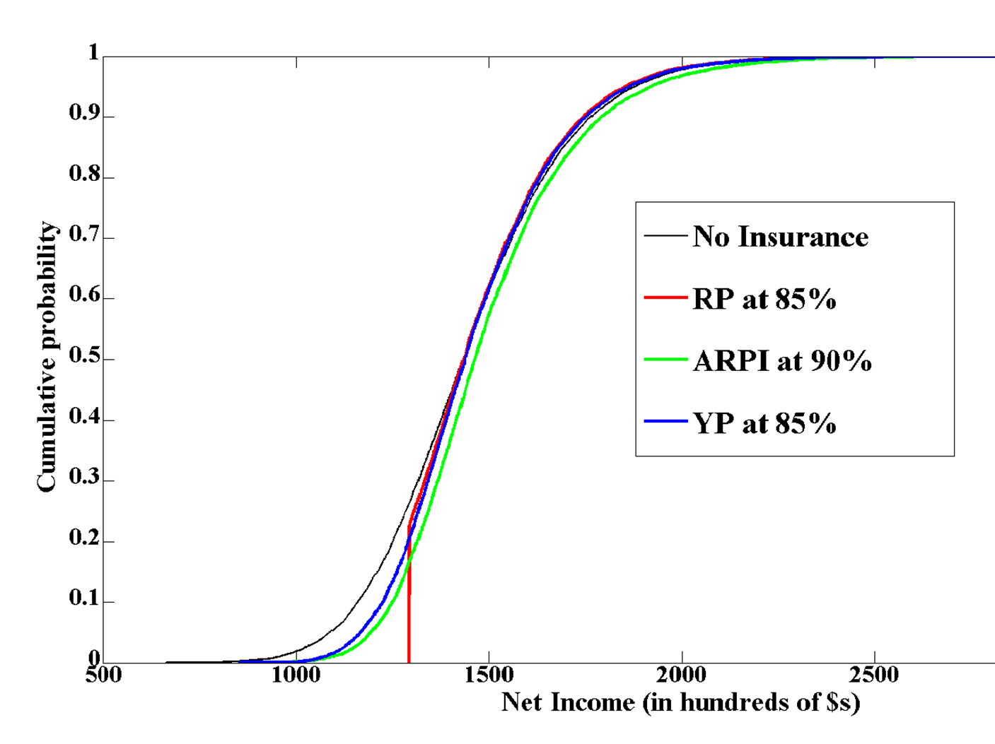
Effect of Crop Insurance on a Simulated Illinois Corn Farm’s Revenue

Slide 21
Crop Ins. v. Commodity Program Benefits Under 2008 Farm Bill, 2008-2012 avg.
 | Net Indemnities | % of Prod. Value | CommodityProgram Outlays | % of Prod. Value
 | $/planted ac. |  | $/planted ac.
Corn | 29.75 | 4% | 20.97 | 3%
Soybeans | 8.81 | 2% | 6.65 | 1%
Wheat | 10.49 | 4% | 19.77 | 7%
Up. Cotton | 63.22 | 11% | 119.63 | 21%
Rice | 9.70 | 1% | 132.44 | 13%
Peanuts | 15.02 | 2% | 73.40 | 8%
Prod. value from ERS http://www.ers.usda.gov/data-products/commodity-costs-and-returns.aspx

Slide 22
AIPs
Number of AIPs operating
Number per State, by State Premium, 2012
Mil $

Slide 23
AIP A&O Payments and UGs as a Share of Gross Premium Sold by the AIPs

Slide 24
How a Company and FCIC Share Gains/Losses Share of Premium, Commercial Fund, GP 1 States
Company Gross Loss Ratio

Slide 25
How a Company and FCIC Share Gains/Losses Share of Premium, Commercial Fund, GP 1 States
IL 4.5
IA & NE 2.2
IN 3.4
Company Gross Loss Ratio

Slide 26
Actuarial Performance of Crop Insurance Loss Ratio = indemnities/premiums
1988
1983
1993
2002
2012

Slide 27
Components of Crop Year Taxpayer Costs (Bil $)
Outlay Method =
Net Indm. + AIP UGs + A&O
Subsidy Method =
Prem. Sub. + FCIC Un. Loss + A&O
Net=$13.3

Slide 28
Real Expenditures on CCC Commodity Programs, Disaster & NAP, Crop Insurance
Bil. 2013 $
Fiscal year
Source: USDA and Congressional Budget Office May 2013 Baseline;
deflated using index of prices received for crops

Slide 29
Policy & Program Issues
Interaction of crop insurance and farm programs
Interaction & Implementation issues: ARC, RLC, SCO, STAX
Private delivery
Concern over delivery cost (different regulatory model, less costly products, alternative approach?)
Premium subsidies
Level and structure
Distribution of A&O across states
Underwriting gains
Degree of public/private risk sharing and returns
Level of market competition and privatization
Rate making, universal coverage, level of oversight

