Slide 1
Imagination Farms: Licensing & Marketing Disney Garden Fresh Produce to Children
Shannon Sand
Kathleen Brooks
July 27, 2008

Slide 2
Children’s Health
1/3 American children & youth are obese or at risk of becoming obese
Low fruit & vegetable intake can lead to obesity
Only 13% of U.S. families w/children eat recommended amount

Slide 3
Marketing To Children
$7.3 billion annually spent on advertising food, beverage, and candy industry
Relatively small amount spent on promotion of fruits & vegetables --- $146 million
Numerous government agencies encouraging corporations to market healthier alternatives
Produce for Health Foundation
2005 National Action Plan
Fruits & Veggies-More Matters
Notes:
PBH working with governments, schools, health entities and industry to promote health through increased fruit and vegetable consumption

Slide 4
Disney’s Efforts for a Healthier Lifestyle
#1 family lifestyle brand
7th in world for overall brand value ($26 billion)
Vision: creating fun & safe products kids love, and are convenient to mom, while being sold at competitive prices
2006 Disney kid-focused products meet specific nutritional guidelines
2006 signed agreement with I-Farms for the licensee for fresh produce in US
Disney.com/healthykids

Slide 5
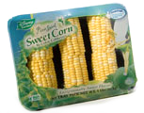
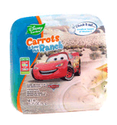
I-Farms Profile
Marketing company of Disney branded fresh produce…Disney Garden
Privately funded
Uses co-packers, licensees who sell and ship the products
Website: i-farms.com

Slide 6
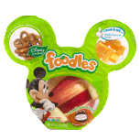
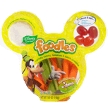
I-Farms Mission
Increase the consumption of fresh fruits & vegetables among children
I-Farms Goal
Become the number one trusted brand for healthful food choices for kids

Slide 7
So What?????
I-Farms contract with Disney ends December 31, 2010
Co-packers license agreements with I-Farms end 2010

Slide 8
Fresh Produce Industry Assessment
Substitutes
Dried, canned, frozen produce
Candy, chips, granola bars, yogurt
Brand vs. non-brand
Suppliers
Small–med suppliers
Large suppliers
Many suppliers (commodities)
Rivalry
High competition
Large # firms
Slow market growth
Perishable goods
Commodities
Buyers
Retailers
Supermarkets
Schools
Institutions
Restaurants
Barriers to Entry
Low barriers to entry
Industries outlook is risky or uncertain
Existing competitors are struggling to earn profits
Seasonality
Cost of inputs
Elasticity

Slide 9
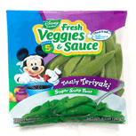
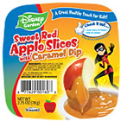
Branding Fresh Produce
Not typically branded
Commodity
Seasonality
Lack of product differentiation
Inconsistent quality
Limited profit margins
Value-added fresh produce more commonly branded

Slide 10
I-Farms SWOT Analysis
Strengths Relationship with Disney brand I-parenting award New product innovation | Weaknesses Contract with Disney ends 2010 Co-packer contracts end 2010
Opportunities Increase consumption of fresh fruits and vegetables among children Expansion of brand into value-added and convenience and organic Contracts with international co-packers Piggyback on Disney contracts | Threats Competition especially at retail level Seasonality-variation in quality and consistency Possible recession-price sensitivity Losing contract to a large producer in fresh produce

Slide 11
I-Farm’s Strategies
Strategy #1: Expansion of value-added, convenient produce
Strategy #2: Expansion of organic produce
Strategy #3: Expansion of co-packers nationally and internationally to decrease threat of seasonality
Strategy #4: Increase brand awareness
Notes:
First three Not feasible in immediate future

Slide 12
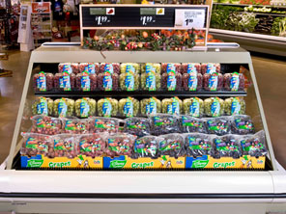
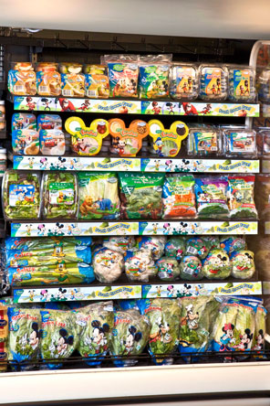
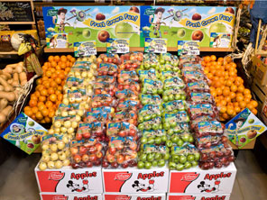
I-Farms display photos at http://www.imagination-farms.net/merchtips.html
Notes:
I-farms merchandising tips for retailers

Slide 13
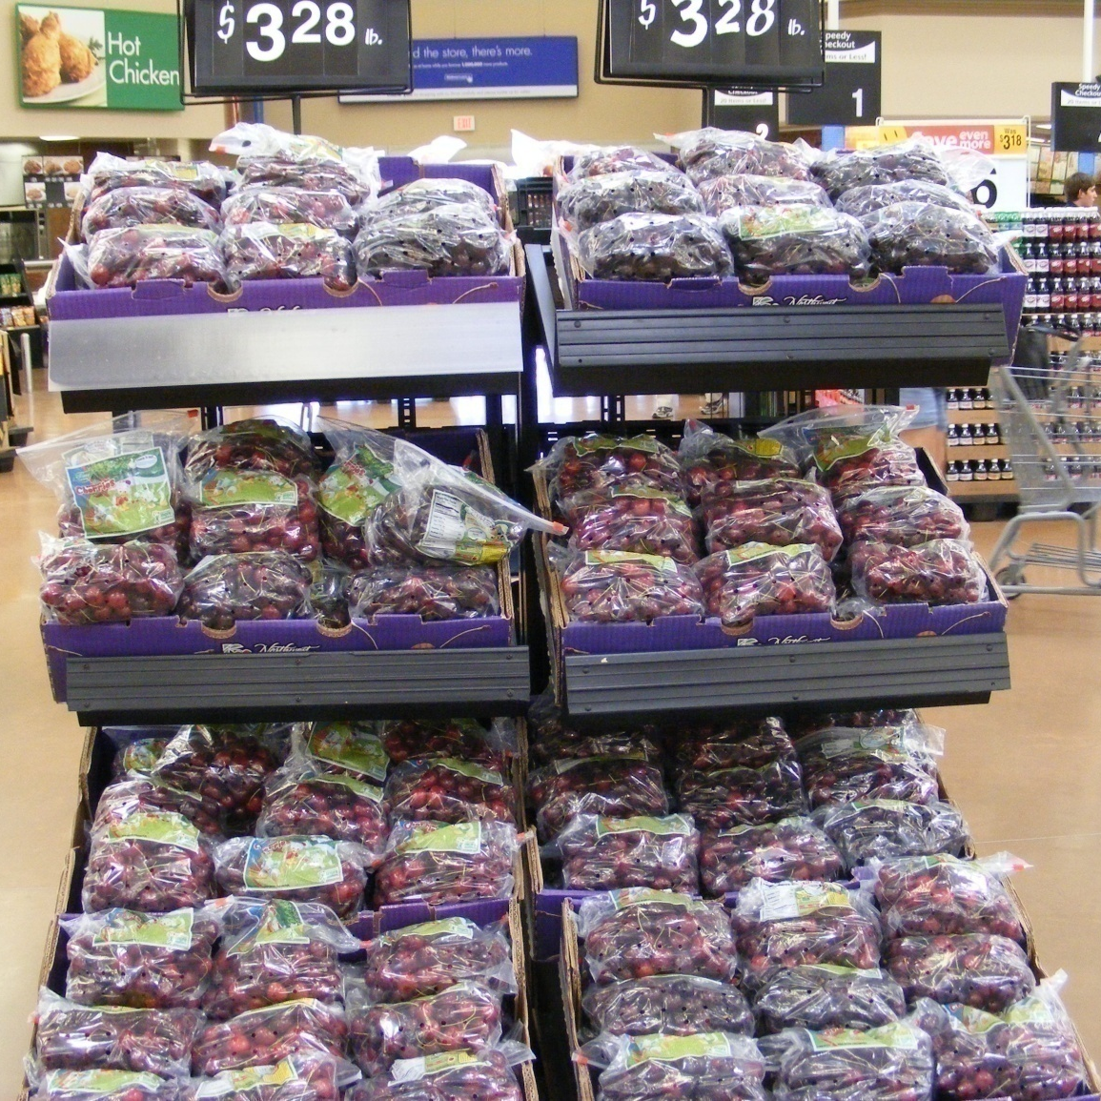
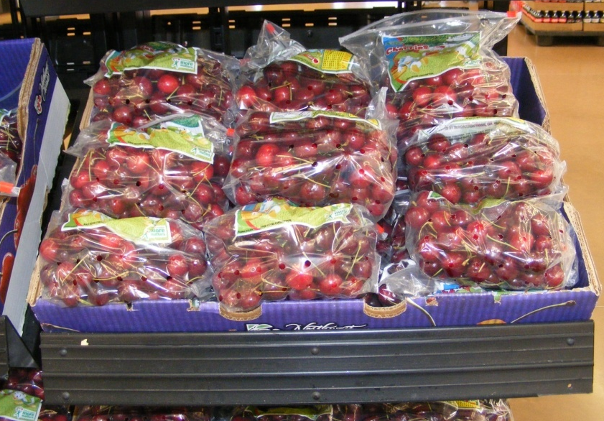
Photos of Disney Garden Produce At Wal-Mart
Notes:
Talk about Dr. Raper’s grapes

Slide 14
Our Brand Awareness Research
Retailers
10 Orlando supermarkets … ground zero
9 out of 10 did not know about Disney Garden
Consumers
Several individuals in supermarkets
Similar response to retailers

Slide 15
Strategy #4: Increase Brand Awareness
Co-packers
Training/education
Produce managers
Marketing information
Incentives
Use of Disney research on consumer preferences
Opportunity: Piggyback on other Disney products
Example
Captain Carlos

Slide 16
I-Farms Future
Immediate future
Contract extension (expires Dec 31, 2010)
Strategy #4: Increase brand awareness
After contracts extended
Strategy #1: Expansion of value-added, convenient produce
Strategy #2: Expansion of organic produce
Strategy #3: Expansion of co-packers nationally and internationally to decrease threat of seasonality

Slide 17
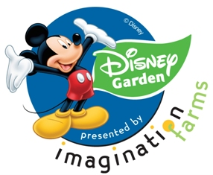
Questions???

Slide 18
References
“Progress in Preventing Childhood Obesity: How do We Measure Up?” Report Brief, Institute of Medicine, September 2006.
World Health Organization (WHO), The World Health Report 2002: Reducing Risks, Promoting Healthy Life, Geneva: WHO, 2002.
“State of the Plate: Study on America’s Consumption of Fruits and Vegetables,” Produce for Better Health Foundation, 2003.
www.disneychannel.com/passtheplate
www.jetix.tv/pyramid
USDA Economic Research Service: www.ers.usda.gov
www.i-farms.com, www.imagination-farms.net/index.html
National Center for Health Statistics. Health, United States, 2004 with Chartbook on Trends in the Health of Americans. Hyattsville, Maryland: 2004.

Slide 19
Elasticity of Fresh Fruits & Vegetables
Inelastic demand for fresh fruits & vegetables
Fresh Vegetables
-.16475
Fresh Fruit
-0.39275
Source: USDA Economic Research Services
CPI

Slide 20
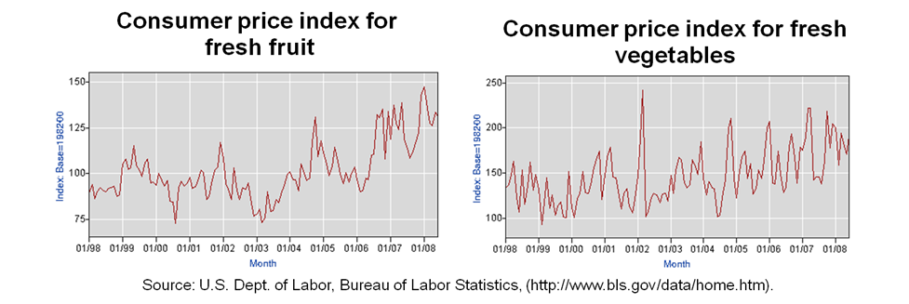
Industry Assessment
Source: Economic Research Service, USDA

Slide 21
Strategy #4

