Slide 1
Corn & Soybean Outlook
AAEA Annual Meeting
14 August 2012
Matthew C. Roberts
Roberts.628@osu.edu

Slide 2
Just Like Old Times…
Grain markets are primarily being driven by fundamentals.
Policy also very important, though.
Corn:
Where does the rationing occur?
What will become of VEETC?
Soybeans:
Final yield?
Global inventories situation

Slide 3
WAOB Corn Demand Rationing
Feed & Residual:
Ethanol:
Exports:

Slide 4
 | 2009/10 | 2010/11 | 2011/12 | 2012/13
 | Final | Final | Current | Current
Area
Planted | 86.4 | 88.2 | 91.9 | 96.4
Harvested | 79.5 | 81.4 | 84 | 87.4
Yield per harvested acre | 164.7 | 152.8 | 147.2 | 123.4
Beginning stocks | 1,673 | 1,708 | 1,128 | 1,021
Production | 13,092 | 12,447 | 12,358 | 10,779
Imports | 8 | 28 | 25 | 75
Supply, total | 14,774 | 14,182 | 13,511 | 11,875
Feed and residual | 5,124 | 4,792 | 4,550 | 4,075
Food, seed & industrial | 5,961 | 6,428 | 6,390 | 5,850
Ethanol | 4,591 | 5,021 | 5,000 | 4,500
Domestic, total | 11,086 | 11,220 | 10,940 | 9,925
Exports | 1,980 | 1,835 | 1,550 | 1,300
Use, total | 13,066 | 13,054 | 12,490 | 11,225
Ending stocks, total | 1,708 | 1,128 | 1,021 | 650
Avg. farm price ($/bu) 2/ | 3.55 | 5.18 | 6.25 | 8.20
Stocks-to-Use Ratio | 13.1% | 8.6% | 8.2% | 5.8%
Days Ending Inventory | 48 | 32 | 30 | 21

Slide 5
Even including DDGS, Feeding at 1996 Levels.
Million Bushels
6726
5537
4798
6150
5275
5563
4075
3876
3941
Year

Slide 6
 | 2009/10 | 2010/11 | 2011/12 | 2012/13
 | Final | Final | Current | Current
Area
Planted | 86.4 | 88.2 | 91.9 | 96.4
Harvested | 79.5 | 81.4 | 84 | 87.4
Yield per harvested acre | 164.7 | 152.8 | 147.2 | 123.4
Beginning stocks | 1,673 | 1,708 | 1,128 | 1,021
Production | 13,092 | 12,447 | 12,358 | 10,779
Imports | 8 | 28 | 25 | 75
Supply, total | 14,774 | 14,182 | 13,511 | 11,875
Feed and residual | 5,124 | 4,792 | 4,550 | 4,075
Food, seed & industrial | 5,961 | 6,428 | 6,390 | 5,850
Ethanol | 4,591 | 5,021 | 5,000 | 4,500
Domestic, total | 11,086 | 11,220 | 10,940 | 9,925
Exports | 1,980 | 1,835 | 1,550 | 1,300
Use, total | 13,066 | 13,054 | 12,490 | 11,225
Ending stocks, total | 1,708 | 1,128 | 1,021 | 650
Avg. farm price ($/bu) 2/ | 3.55 | 5.18 | 6.25 | 8.20
Stocks-to-Use Ratio | 13.1% | 8.6% | 8.2% | 5.8%
Days Ending Inventory | 48 | 32 | 30 | 21

Slide 7
The irrelevance of an RFS waiver has been greatly exaggerated.
Gasoline can be refined to very high octane levels—catalytic cracked gas is 95 octane.
But is costlier
MTBE was added to gasoline as an oxygenate, not for octane.
But in 2007 EISA, explicit oxygenation requirements abolished.
Because of increased availability/RFS, blenders utilized EtOH for octane as well as O2.

Slide 8
The irrelevance of an RFS waiver has been greatly exaggerated. (2)
But many other additives can supply octane.
The question is at what price.
Historical rule of thumb was 1-2c/g/pt
2012: 13.2bn gallon RFS, 2013: 13.8bn gallons
Current Prices:
 | Ethanol | RBOB
Cash | 2.51 | 3.10
U12 | 2.56 | 2.99
Z12 | 2.49 | 2.72
H13 | 2.46 | 2.73

Slide 9
Ethanol Production Volumes Down in Last Three Months

Slide 10
 | 2009/10 | 2010/11 | 2011/12 | 2012/13
 | Final | Final | Current | Current
Area
Planted | 86.4 | 88.2 | 91.9 | 96.4
Harvested | 79.5 | 81.4 | 84 | 87.4
Yield per harvested acre | 164.7 | 152.8 | 147.2 | 123.4
Beginning stocks | 1,673 | 1,708 | 1,128 | 1,021
Production | 13,092 | 12,447 | 12,358 | 10,779
Imports | 8 | 28 | 25 | 75
Supply, total | 14,774 | 14,182 | 13,511 | 11,875
Feed and residual | 5,124 | 4,792 | 4,550 | 4,075
Food, seed & industrial | 5,961 | 6,428 | 6,390 | 5,850
Ethanol | 4,591 | 5,021 | 5,000 | 4,500
Domestic, total | 11,086 | 11,220 | 10,940 | 9,925
Exports | 1,980 | 1,835 | 1,550 | 1,300
Use, total | 13,066 | 13,054 | 12,490 | 11,225
Ending stocks, total | 1,708 | 1,128 | 1,021 | 650
Avg. farm price ($/bu) 2/ | 3.55 | 5.18 | 6.25 | 8.20
Stocks-to-Use Ratio | 13.1% | 8.6% | 8.2% | 5.8%
Days Ending Inventory | 48 | 32 | 30 | 21

Slide 11
World Wheat Supplies Far Better Situation than ’07/08
Use 683
Production 662
Stocks-to-Use Ratio (%)
Source: WOAB, USDA
Notes:
July 2012

Slide 12
Global Corn Inventories Very Low
Use 861
Production 849
Stocks-to-Use Ratio (%)

Slide 13
Corn Summary
Feed Demand Drop Very Large…
Will this ever recover?
Ethanol Demand Still Might be Able to Be Rationed Further, but price relative to RBOB will keep it blended, even with reduced RFS.

Slide 14
Soybeans:
Global Situation Very Tight
2012 Drought in US
2012 Drought in S. Am
How will August Treat Soybeans?
Poor Growth Prospects, Even with Moisture
What is the elasticity of Chinese Demand?

Slide 15
S.Am ‘13 forecast is 30mmt greater than ‘12 production…
Million Metric Tons
Production 260
Stocks-to-Use Ratio (%)
Use 257

Slide 16
 | 2010/11 | 2011/12 | 2012/13
 | Final | Current | August
Area
Planted | 77.4 | 75.0 | 76.1
Harvested | 76.6 | 73.6 | 74.6
Yield | 43.5 | 41.5 | 36.1
Beginning stocks | 151 | 215 | 145
Production | 3329 | 3056 | 2692
Imports | 14 | 15 | 20
Supply, total | 3495 | 3286 | 2857
Crushings | 1648 | 1690 | 1515
Exports | 1501 | 1350 | 1110
Seed | 87 | 88 | 89
Residual | 43 | 13 | 27
Use, total | 3280 | 3141 | 2742
Ending stocks | 215 | 145 | 115
Stocks/Use Ratio | 6.6% | 4.6% | 4.2%
MYA Price | 11.30 | 12.45 | 16.00

Slide 17
Soybean Exports Fall to ’06/07 levels?
Million Bushels
1063
1110
929
804
885
589
527

Slide 18
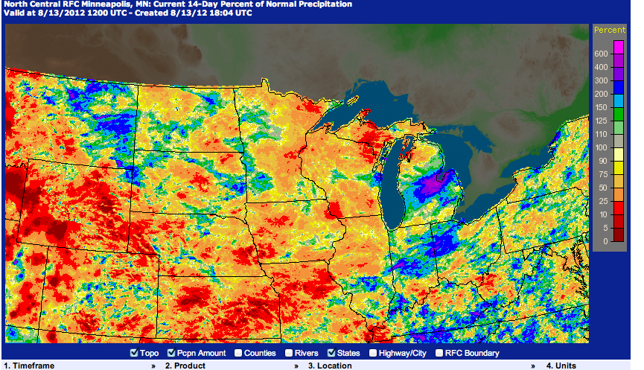
Some Optimism Over Recent Rain

Slide 19
Soybean Summary
Global Markets Very Tight, Dependent on S. Am Crop.
Weather related weakness overdone.
Export Demand probably underestimated.
Room for higher prices w/ Soy.

Slide 20
Matt Roberts
(614) 688-8686
roberts.628@osu.edu
http://aede.osu.edu/people/roberts.628
Twitter: @YourEconProf

