Slide 1

Policy Options and Consequences for the 2012 Farm Bill:
Whole Farm Revenue
Joe L. Outlaw
Professor & Extension Economist
Co-Director, AFPC
AAEA Annual Meeting
Pittsburgh, PA
July 26, 2011

Slide 2
Presentation Outline
Background
Representative Farm Results
Issues to Consider
Conclusions
Whole Farm
Revenue

Slide 3
Background
Whole Farm Revenue Protection has been discussed as a potential producer “safety net” for consideration in the next farm bill
In it’s simplest form:
  Determine a base revenue (P_{i}*Q_{i}) to be protected and coverage %
Not hearing much about it now
Could be developed as a replacement for all current programs or as an addition to…
Urban gardens/poultry

Slide 4
Representative Farm Results
Farm level economic impacts of whole farm revenue program in lieu of current crop insurance and government program payments on agricultural producers in major production areas of the United States
Picked a subset of 10 (2 each of feed grains, wheat, cotton and rice)
Urban gardens/poultry

Slide 5
Location of Selected AFPC Representative Farms
WAW
NDG
WY
IAG
CACR
NEG
KSNW
NM
ARWR
TXEC
GAC
TXER

Slide 6
Scenarios Analyzed
Base – Maintains government payments and crop insurance program in which the farm is typically enrolled through 2017
90% Revenue Coverage – Assumes 90% Whole Farm Revenue Coverage replaces government payments and crop insurance for 2010-2017 projection period
95% Revenue Coverage – Assumes 95% Whole Farm Revenue Coverage replaces government payments and crop insurance for 2010-2017 projection period
98% Revenue Coverage – Assumes 98% Whole Farm Revenue Coverage replaces government payments and crop insurance for 2010-2017 projection period
Calculated “fair premium” based on average payout over 2010-2017 projection period for each coverage level

Slide 7
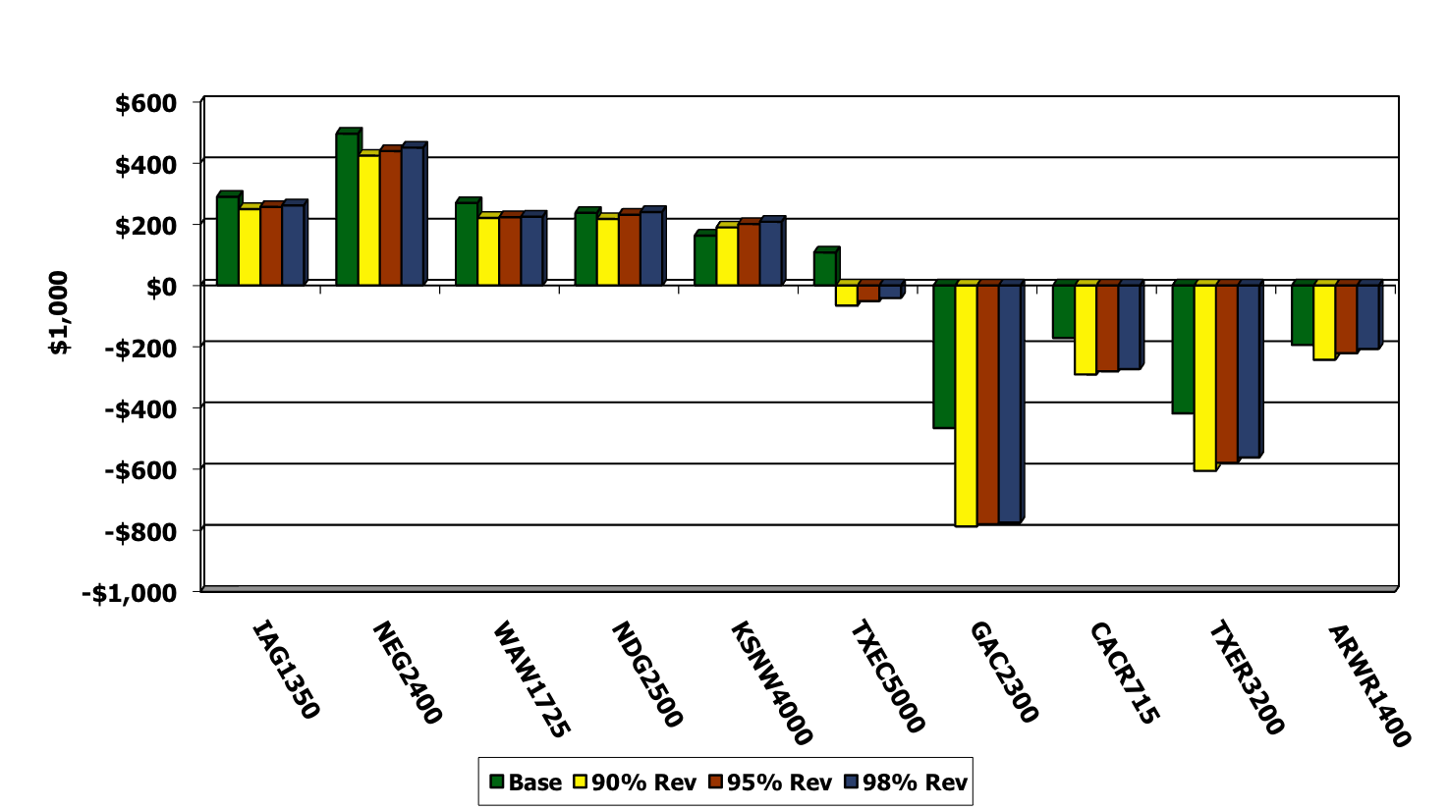
Comparison of Average Net Cash Farm Income Resulting from Enrollment in 3 Alternative Coverage Levels of Whole Farm Revenue Program, 2010-2017
Eight of ten farms prefer the Base scenario over all alternative levels of Whole Farm Revenue Program coverage

Slide 8
Issues to Consider
As most things.. Devil is in the details
  Base
    What Sources of Revenue to Include?
    How Many Years?
    Farm yields, but what price?
  Trigger
    What to Include and Exclude?
    Interaction With Crop Insurance?
    Farm yields, but…
Urban gardens/poultry

Slide 9
Issues to Consider (Cont.)
Strengths:
  Could apply to all 2.1 million (could provide protection for all farms)
    Livestock??
    Covers price and revenue
Weaknesses:
  Could apply to all 2.1 million (cost prohibitive)
  A bad base is a bad base
  Cost
Urban gardens/poultry

Slide 10
Conclusions
Prior Leadership in House of Representatives was at least interested in Whole Farm Revenue Protection
Doesn’t appear to be much interest now
Has potential but… could be considerable overlap with crop insurance
Would be much easier to understand than ACRE
High coverage levels would eliminate the need for SURE
Urban gardens/poultry

