Slide 1
Wheat
July 25, 2011

Slide 2
Wheat is not wheat
Outlook
Bold predictions
2012

Slide 3
Wheat is not wheat
high protein vs. low protein
red vs. white
hard vs. soft
common vs. durum
food vs. feed

Slide 4
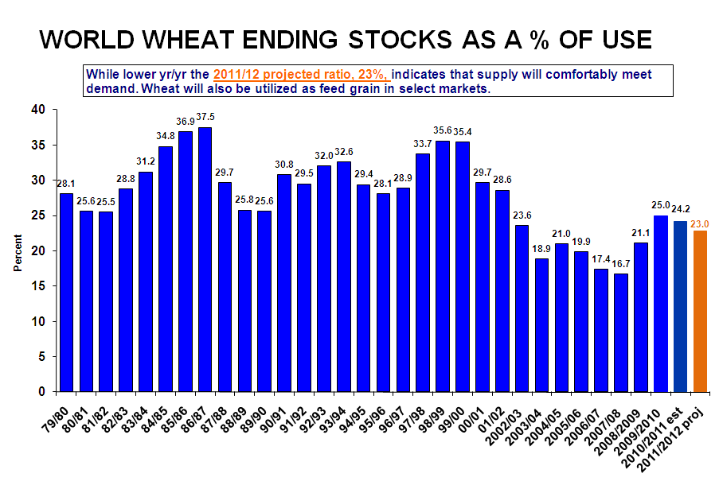

World Outlook: Wheat stocks are comfortable, but declining for the second year in a row.

Slide 5
Quiz Time!
Which country is the largest wheat exporter in the world?
Canada
United States
Russia
Australia

Slide 6
Quiz Time!
Which country is the largest wheat exporter in the world?
Canada
United States
Russia
Australia
→

Slide 7
Quiz Time!
Which country exports the most wheat, relative to their total wheat production?
Canada
United States
Russia
Australia

Slide 8
Quiz Time!
Which country exports the most wheat, relative to their total wheat production?
→
Canada
United States
Russia
Australia
In an average year, Canada will export 70% of production. The U.S., Australia, Argentina and Kazakhstan will also export 50% or more.

Slide 11
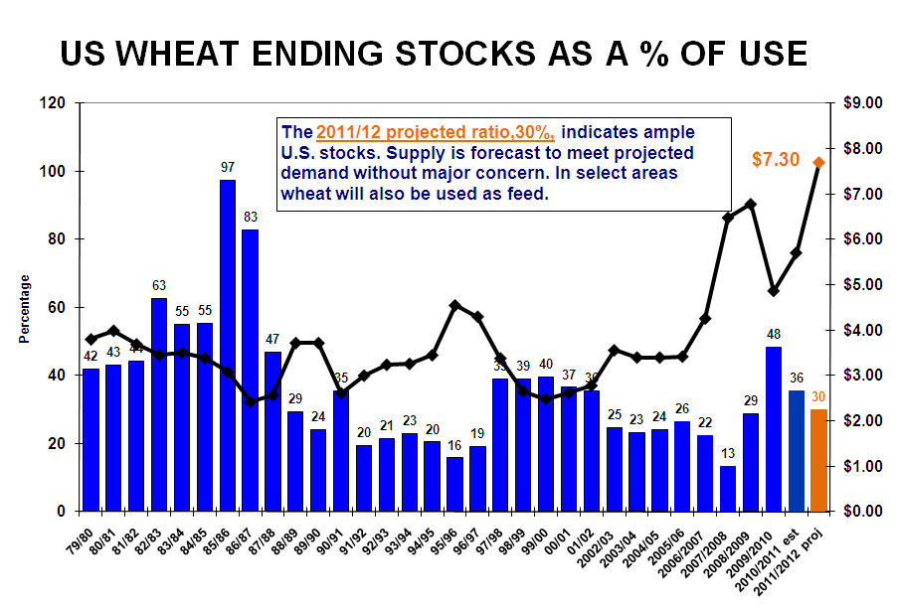
U.S. Outlook: Wheat stocks are comfortable, but declining for the second year in a row.

Slide 12
U.S. Wheat Highlights
HRW –smallest crop since 2006 (yields )
HRS – smallest crop in 4 years (acres and yields )
SRW – 2nd largest crop in 10 years (acres & yields )
SWW – largest crop in six years (acres & yields )
Durum – 2nd smallest crop since 1988 (acres )

Slide 13
Wheat is not wheat
hard vs. soft
high protein vs. low protein

Slide 18
Bold predictions

Slide 19
Quiz Time!
After corn, which grain is most commonly used as feed in the U.S. and in the world?
Barley
Oats
Sorghum
other

Slide 20
Quiz Time!
After corn, which grain is most commonly used as feed in the U.S. and in the world?
Barley
Oats
Sorghum
other (wheat!)
→

Slide 22
Is there room for even more wheat feeding in the year ahead?

Slide 23
The CBOT July wheat contract averaged 97% of the July corn contract in the month of June, the lowest ratio in my records.

Slide 25
Wheat feeding in 1977/78 is greater than the previous 3 years combined.

Slide 26
Wheat feeding in 1984/85 tops 400 mb for the first time ever.

Slide 27
…and again tops 400 mb in 1986/87.

Slide 28
Wheat feeding in 1990/91 reaches 500 mb.

Slide 29
The last three years when wheat feeding topped 300 mb.

Slide 30
Wheat feeding of 220 mb in 2011/12?

Slide 31
1990
2011 proj.
2007

Slide 32
1990
2011 proj.
2007

Slide 33
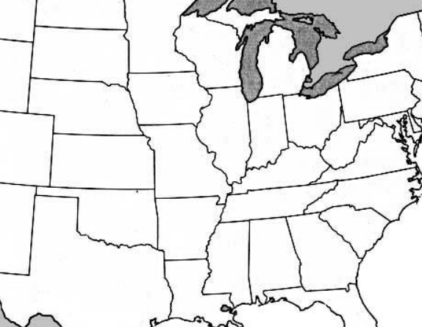
SC PA
corn: $7.23
wheat: $5.73
USDA Grain Market News

Slide 34
Statesville, NC
corn: $7.25
wheat: $6.50
USDA Grain Market News

Slide 35
Louisville, KY
corn: $7.29
wheat: $6.47
USDA Grain Market News

Slide 36
Toledo, OH
corn: $7.50
wheat: $6.80
USDA Grain Market News

Slide 37
SC IL
corn: $7.20
wheat: $6.50
USDA Grain Market News

Slide 38
Central MO
corn: $7.15
wheat: $6.60
USDA Grain Market News

Slide 39
Western, NE
corn: $7.00
wheat: $6.80
USDA Grain Market News

Slide 40
Northeast CO
corn: $7.20
wheat: $7.00
USDA Grain Market News

Slide 41
Triangle Area, TX
(Plainview to Canyon to Farwell)
corn: $7.05
wheat: $7.05
USDA Grain Market News

Slide 42
2012
HRW – plant in the dust?
The future of the Canadian Wheat Board

Slide 43
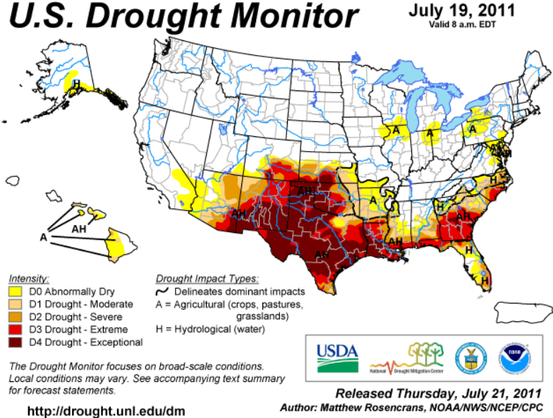

Slide 44
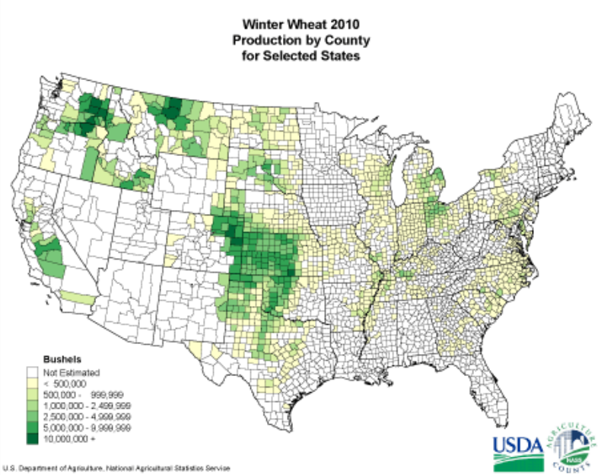

Slide 45
The future of the Canadian Wheat Board
[In Canada], the federal government intends to end the Canadian Wheat Board’s monopoly on wheat and barley by August 2012 and thereby permit western farmers to sell on an open market if they wish, just as farmers in the United States and throughout Europe do.
Winnipeg Free Press June 11, 2011

Slide 46
Wheat is not wheat
Outlook: Wheat stocks are comfortable, but declining for the 2nd year in a row.
Bold predictions: We will feed more wheat and, as goes the price of corn, so goes the price of wheat
2012

