Slide 1
Key Ethanol & DGS Issues, Short-term and longer-term AAEA Extension Crops Outlook Session July 25, 2011
Dr. Robert Wisner, University Professor Emeritus, Iowa State University
Dr. Daniel O’Brien, Extension Agricultural Economist, Kansas State University

Slide 2
Key Ethanol & DDGS Issues
Loss of Blenders’ Tax Credit & Import Tax --Will mandates prevent reduced production? -- Will imports surge?
The Blend Wall: Are we there yet?
DDGS: how many bu. corn & SBM equiv.?
Bu. needed for ethanol in 2011-12 & 2012-13?
Corn: acres needed for ethanol in 2011-12 & 2012-13?
Future trend in needed acres for biofuels

Slide 3
California Variable credit
Goes to producer, not blender
Based on crush spread
If nearby CBOT corn/LA ethanol price <$0.55, plant receives subsidy
Subsidy: difference between $.55/gal & avg. monthly crush margin, up to $.25/gal.
If monthly crush margin>$1.00/gal., producer pays back amount crush margin >$1.00
Cap of $3 mil./plant
Requires either decrease corn use by 20% or reduce carbon footprint

Slide 4
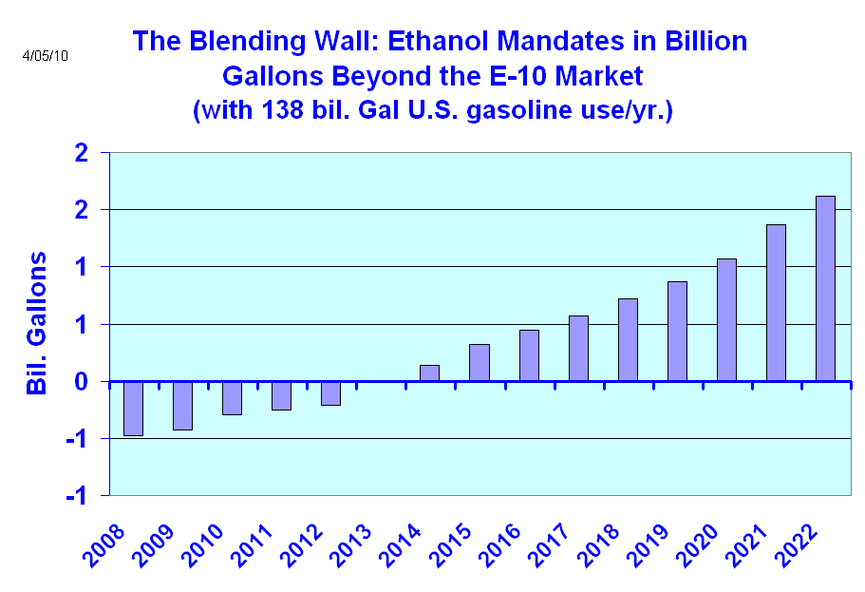
Includes cellulosic ethanol – cellulose revenue impact on corn vs. SB acres?
2010-11 Corn Starch Ethanol Production: 5.0 bil. bu. = 13.9 bil. gal.
Ethanol Exports: 0.4 bil. gal. ?

Slide 5
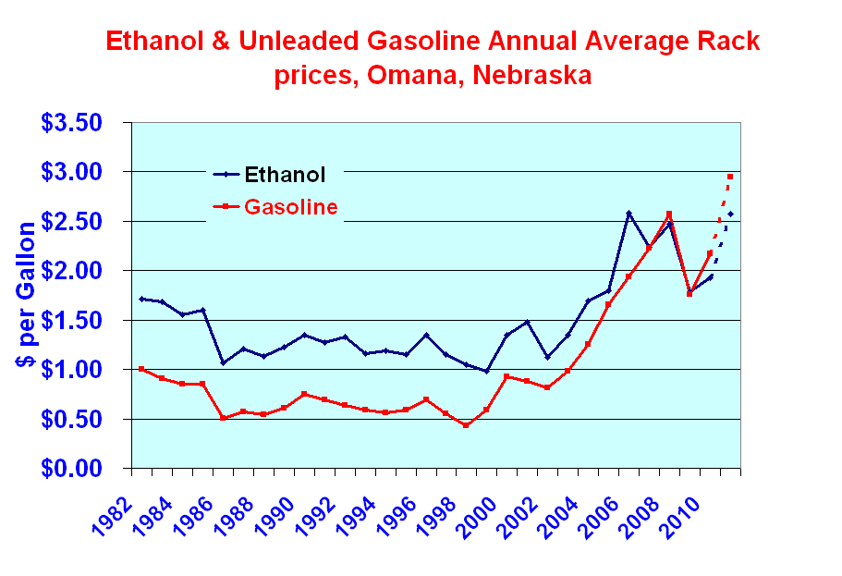

Slide 6
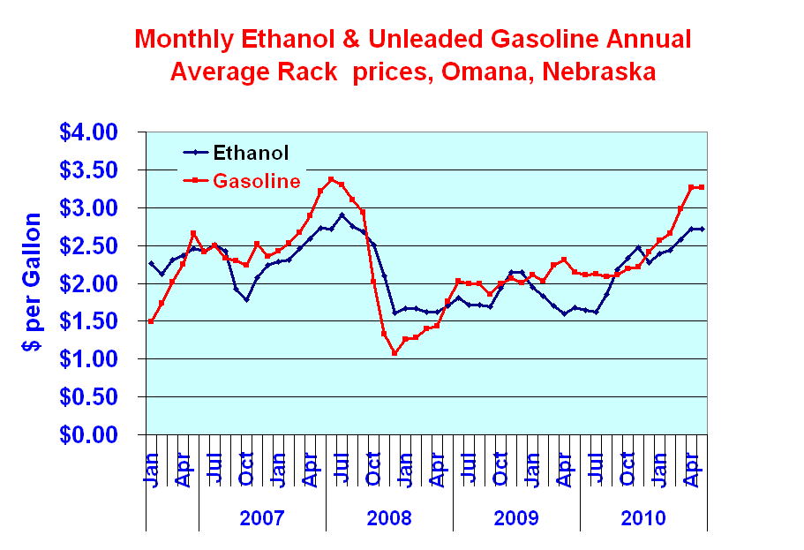

Slide 7
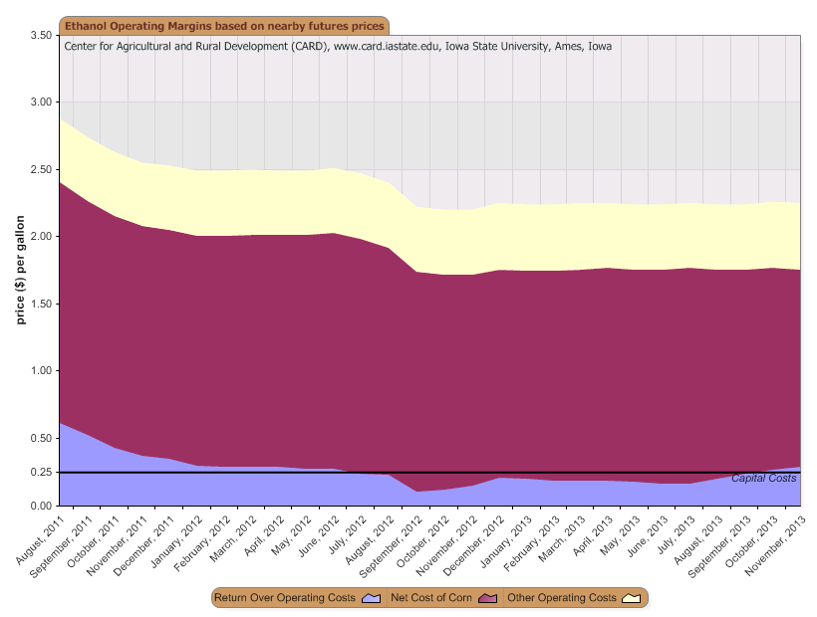
Source: CARD, ISU

Slide 8
Ethanol Mkt. Year Production vs. Govt. Mandates (Bil. Gal. & Mil. Bu.)
EPA Corn Bu. Mand’t Equiv.
2008-09
2009-10
2010-11
2011-12
2012-13
2013-14
2014-15
2015-16
Corn Bu. Excess For eth. vs. Mand’t
10.0
11.5
12.4
13.0
13.6
14.2
14.8
15.0
3,597
4,137
4,460
4,676
4,892
5,108
5,324
5,396
3,677
4,568
5,050
5,150?
5,180?
5,300?
5,350? 5,400?
80
431
540
374
288
192
26
4
Marketing year data

Slide 9
Implications of losing blenders’ credit & import tax
Corn volume for ethanol may be reduced
Reduction depends on rack ethanol vs. gas prices
May be modest in short term, with current wide ethanol-gasoline price spread
Implications for cellulosic ethanol & its investors are serious
Short-term, don’t look for big ethanol imports. Longer-term, imports could meet a substantial part of advanced biofuels mandates & compete with corn starch ethanol

Slide 10
Emerging Biofuels Policy Issues, Cont.
Concerns of industries relying on ag-based biofuels feedstocks
Food manufacturers
Livestock & poultry industries: what happens in a short-crop year, with mandates?
Foreign buyers, with advantage of weak $

Slide 11
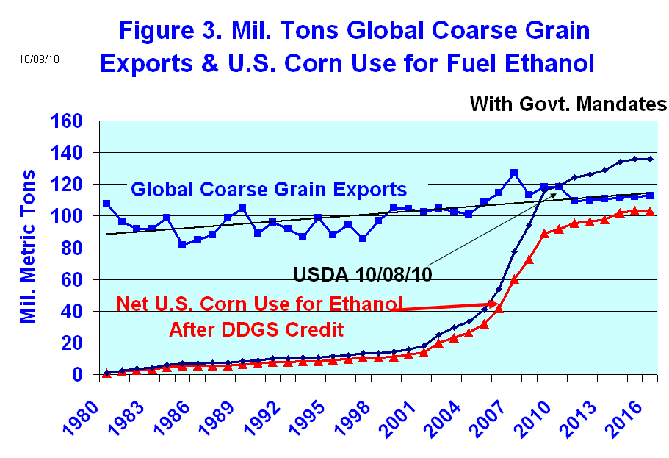
Another reason grain users are concerned about ethanol

Slide 12
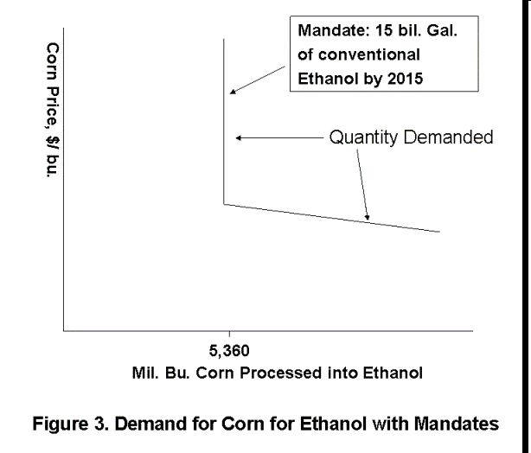

Slide 13
Short Crops & Ethanol
Need for pre-determined rules on how to adjust & how ethanol & livestock might share the adjustment
Potential economic impacts: large
Current system: decisions by Energy & Ag Secretaries – probably as or after crisis has emerged

Slide 14
Wisner 2011-12 Corn for Ethanol projections
Corn for Ethanol DGS m. bu. m. bu. crn. equiv.
4,825 1,100
4,950 1,115
5,050 1,150
2010-11
5,000 1,145
2009-10
4,568 1,045
Corn Yield, Bu./A.
148.8
153
159
Comparisons:
2010-11
152.8
2009-10
164.7
Assumes blenders’ tax credit & import tax
will not be renewed
DGS has rounded numbers

Slide 15
Corn Acres Needed for Ethanol
Gross Mil. A.
2009 27.7
32.7
2011 31.3
2012 31.7
Net Mil. A.
2009 17.0
2010 21.8
2011 22.7**
2012 23.4**
* After DGS corn & SBM + corn oil credits
** With trend yields

Slide 16
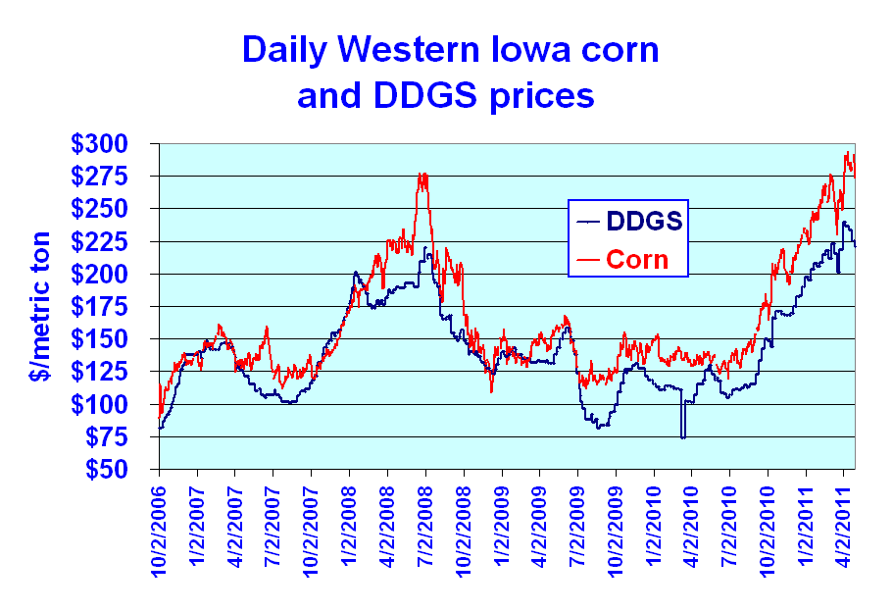

Slide 17
DGS/Corn Replacement Ratios
Avg. | 1.10 |  | 0.59 |  | 0.80 |  | 0.55
Beef Dairy Hogs Poultry

Slide 20
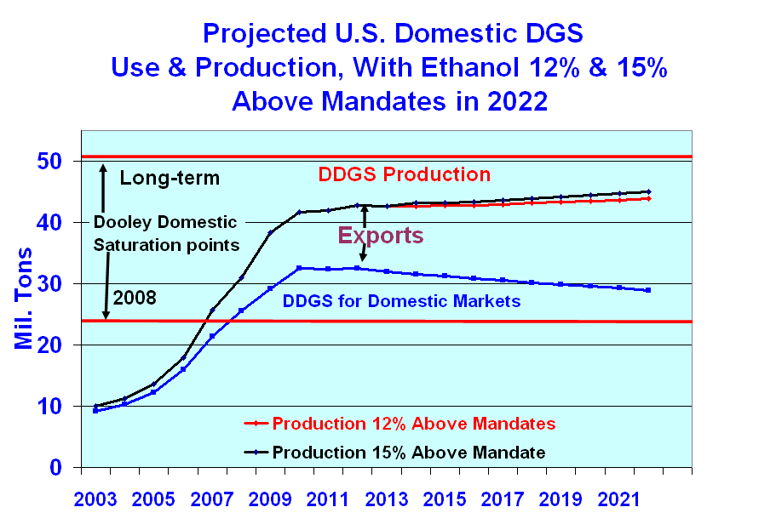

Slide 21
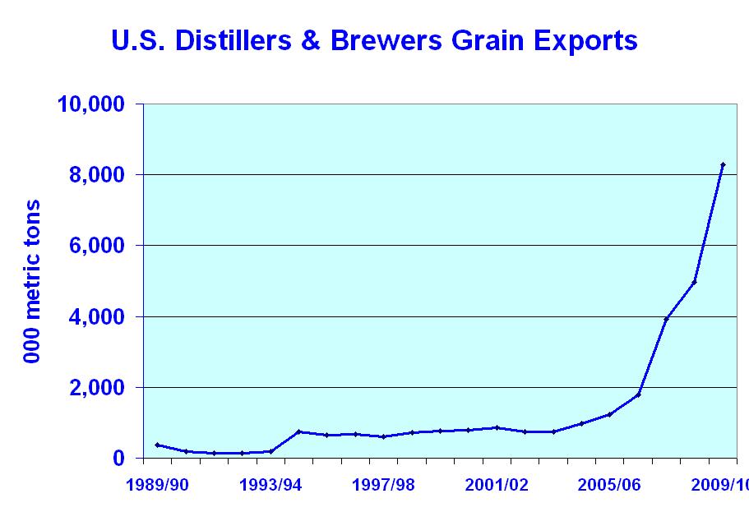

Slide 23
E-15 blends
E-15 for 2001 & newer vehicles = about 40% of vehicles
Divided market creates infrastructure issues
Retailer concerns: investment, space, liability issues
Modified rules may simplify application of blender pumps
Concerns of off-road users: how to get non-ethanol gas
Concerns of auto manufacturers: emissions equipment
The future? Conversion to butanol, other drop-in fuels, pipeline transport?
E-85: lack of retail outlets & lack of competitiveness
Solution to blend wall a key for cellulosic ethanol including that from corn stover
Bottom line: look for slow increase in ethanol demand instead of immediate jump

Slide 24
Est. DGS Equivalent in Mil. Short tons SBM, 2010-11
Domestic SBM 4.78
SBM exports 1.60

Slide 26
Conclusions for 2011-12 Corn Outlook
Blend Wall & lost blenders tax credit may stabilize or possibly reduce corn processing for ethanol. 2011-12 Likely range: 4.8 to 5.05 bil. bu., depending on 2011 corn crop size
Large ethanol imports look questionable for 2011-12, but depend on size of world sugar crop
For longer term, ethanol imports may be more significant if import tax eliminated
Future of corn stover ethanol at risk with blend wall & removal of import tax
If blend wall is removed & cellulose subsidies continue, impact of $50-$60/A. stover revenue on corn vs. soybean acres?

Slide 27
Wisner Contact Information
wisner@iastate.edu
27

