Slide 1
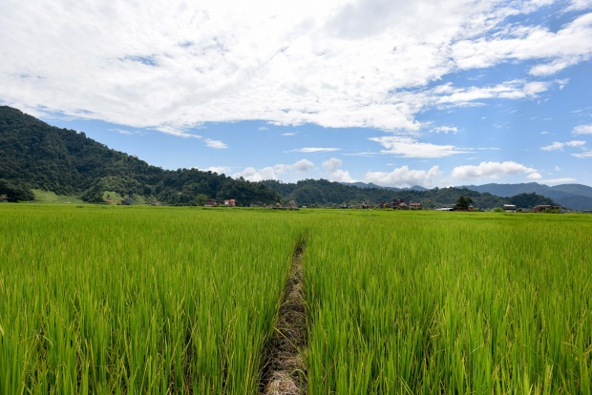
Seeds of Learning: Ecosystem-Based Adaptation Interactive Game
Babatunde Abidoye, United Nations Development Programme (UNDP)
Sahan T. M. Dissanayake, Portland State University
Sarah A. Jacobson, Williams College
January 2021
Photo from https://ccafs.cgiar.org/blog/special-issue-agriculture-development-climate-smart-agriculture#.WpkAsuhubD5

Slide 2
Learning Objectives
Climate change’s impacts on agriculture in developing countries
Externalities from agriculture
Voluntary cooperation in the presence of externalities
Ecosystem based adaptation
Conservation contracts (flat payments and auctions)
Behavior under uncertainty
Adoption of new technologies
Learning spillovers

Slide 3
Climate Change
Net emission of greenhouse gases increases temperature globally
Temperature increase hurts people directly, changes precipitation patterns, and alters ecosystems
Mitigation reduces emissions, to reduce climate change
Adaptation is costly actions taken by people or governments to reduce damages from climate change
Damages are the costs borne by people as a result of climate change, given the adaptation and mitigation that have been done

Slide 4
Climate Change & Agriculture in Developing Countries
Tropical latitudes and low-lying areas expect largest damages
Increased temperature
Shifting precipitation patterns
More variability, more extreme events
→ More erosion from extreme precipitation patterns
→ Ecosystems and cultivated land are becoming more vulnerable

Slide 5
Ecosystem Services: Efficiency and Cost-Effectiveness
Ecosystem services: benefits we get from naturally-functioning ecosystems
Examples: carbon sequestration, flood prevention, aesthetic value
These are usually positive externalities
Efficiency: fix the externality → get the right amount of conservation
Cost-effectiveness: get a level of conservation at the least possible cost
Opportunity cost of conservation varies
The lowest-cost land should be enrolled
Allocative efficiency

Slide 6
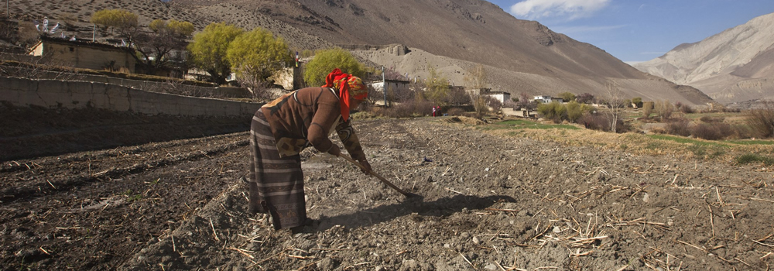
Ecosystem Based Adaptation
Ecosystem Based Adaptation
Photo from http://web.unep.org/climatechange/adaptation/what-we-do/ecosystem-based-adaptation

Slide 7
Ecosystem-Based Adaptation (EBA)
Adaptation: costly actions that can be done to reduce damages
Ecosystem-based adaptation:
“Ecosystem-based adaptation is the use of biodiversity and ecosystem services as part of an overall adaptation strategy to help people to adapt to the adverse effects of climate change.” Convention on Biological Diversity (2009)
Promoted by UN and other international NGOs
EBA used in agriculture to reduce climate damages to productivity AND to reduce impact of agriculture on ecosystems
Conservation of water supplies in conditions that increase erosion
Private benefits and public benefits… but private costs

Slide 8
Example EBA Practices in Agriculture
Riparian buffer strips
Low-till farming
New seed varieties
Mulching
Cover crops

Slide 9
Payments for Ecosystem Services (PES)
PES can internalize public goods’ externality (monetize ecosystem services)
Voluntary participation: ensures low-opportunity-cost land enrolls
Payments can be posted price or auction
Posted price = government declares a payment they’ll offer; land users decide whether to enroll based on that price
Auction = possible participants declare bids; government decides which to accept and how much to pay
Auction is helpful if policymaker doesn’t know distribution of costs

Slide 10
The EBA Game
You are a subsistence farmer in a low-income country
Weather is changing → erosion is increasing
Government wants to promote EBA
But many EBA practices are experimental: we don’t know how they’ll work!
Or they’ve been tested only in other climates
In each of a series of contract periods, you’ll decide whether to adopt the contract for different EBA practices, with different circumstances.

Slide 11
Contract Periods
1: No Government Involvement
2: Flat Adoption Subsidy
3: Conservation Auction
4: Uncertain Direct Effect
5A & 5B: Uncertain but Correlated Direct Effects
6A & 6B: Pilot Bonus

Slide 12
Participant Earnings Each Round
Your Farming Value is your card * 1,000 (shillings)
Earnings each round =
Direct farming earnings: Farming Value if no-one in community adopts EBA, increased by 5% for each person (including you) who adopts
Reflects EBA ecosystem benefits shared by local farmers through water quality
Plus or minus EBA effect on farm productivity if adopt
Depends on EBA, and in some cases also depends on chance (weather / technology)
Minus adoption cost if adopt: in real life this is labor, represent here as 1,000
Plus government payments if adopt and if there are payments
Depends on policies in place
₼
₼

Slide 13
Disclaimer: The EBA Effects In the Game Are NOT Indicative of How These Practices Actually Perform!
We made up numbers & matched them to names of EBA practices
Actual effects of practices seem to incompletely understood by scientists
General idea (uncertainty, some possible sacrifice) does seem true

Slide 14
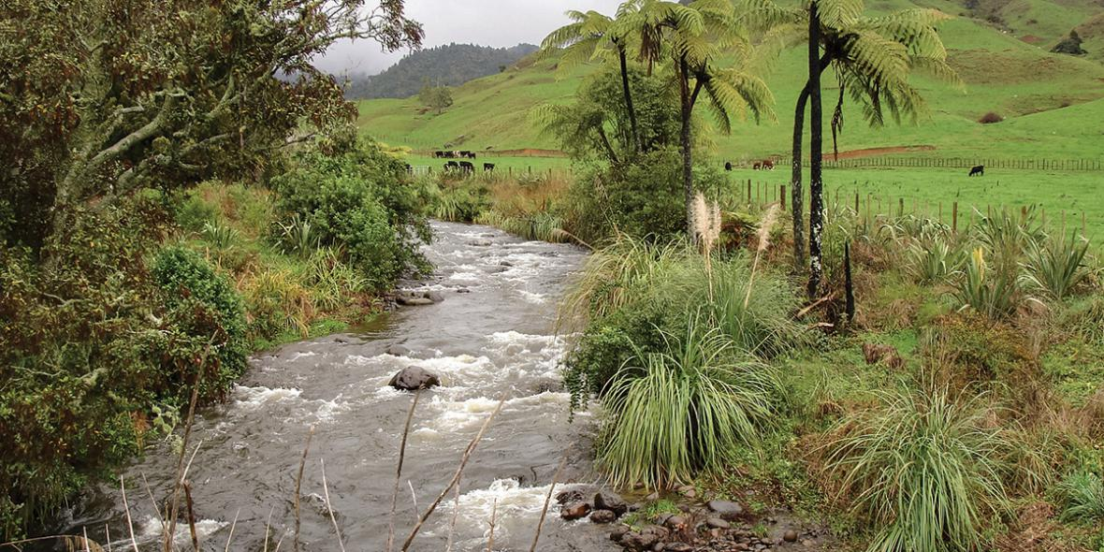
Our First EBA Practice: Riparian Buffer Strips
Photo from https://www.niwa.co.nz/news/dairy-turns-the-corner

Slide 15
Riparian Buffer Strip
(a.k.a. riparian buffer, stream buffer, buffer strip)
Give up strips of otherwise-farmable land on edges of stream / river
These usually are the best land: best soil and water
Planted with natural vegetation that reduces erosion and filters runoff into waterway
Also may provide habitat for wildlife

Slide 16
Conservation Period 1: No Government Involvement
EBA practice: riparian buffer strip
Reduces direct farming income by 10%
Cost to adopt: 1,000
Government payment to adopt: none
Ecosystem service benefits: 5% times number of adopters
Earnings if adopt:
Earnings = Farming Value * (1 + # adopters * 5%) – Farming Value * 10% – 1,000
Earnings if don’t adopt:
Earnings = Farming Value * (1 + # adopters * 5%)
₼
₼

Slide 17
Conservation Period 2: Flat Adoption Subsidy
EBA practice: riparian buffer strip
Reduces farming income by 10%
Cost to adopt: 1,000
Government payment to adopt: 1,500
Ecosystem service benefits: 5% times number of adopters
Earnings if adopt:
Earnings = Farming Value * (1 + # adopters * 5%) – Farming Value * 10% + 500
Earnings if don’t adopt:
Earnings = Farming Value * (1 + # adopters * 5%)
₼
₼
₼

Slide 18
Conservation Period 3: Conservation Auction
EBA practice: riparian buffer strip
Reduces farming income by 10%
Cost to adopt: 1,000
Government payment to adopt: smallest bid not accepted
Ecosystem service benefits: 5% times number of adopters
Earnings if adopt:
Earnings = Farming Value * (1 + # adopters * 5%) – Farming Value * 10% – 1,000 + auction payment
Earnings if don’t adopt:
Earnings = Farming Value * (1 + # adopters * 5%)
₼
₼

Slide 19
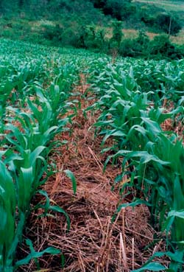
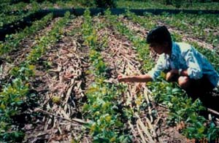
Our Next EBA Practice: Low-Till / No-Till Farming
Photos from http://www.fao.org/docrep/009/a0100e/a0100e07.htm

Slide 20
Low-Till and No Till Farming
Conventional agriculture: till soil to remove old weeds and previous crop
Often mechanized
Low-till or no-till: drill through soil to plant seeds with less soil disturbance
Often more manual (more labor) – especially to fight weeds all season
Reduces erosion by maintaining soil structure
Lets soil hold more water
Reduces release of greenhouse gases from soil

Slide 21
Conservation Period 4: Uncertain Direct Effect
EBA practice: low-till / lo-till farming
Farming income may go down or up: effect may be -30% to +10% each with equal likelihood (Weather Yield Effect)
Cost to adopt: 1,000
Government payment to adopt: 1,500
Ecosystem service benefits: 5% times number of adopters
Earnings if adopt:
Earnings = Farming Value * (1 + # adopters * 5%)
+/– Farming Value * (Weather Yield Effect) + 500
Earnings if don’t adopt:
Earnings = Farming Value * (1 + # adopters * 5%)
₼
₼
₼

Slide 22
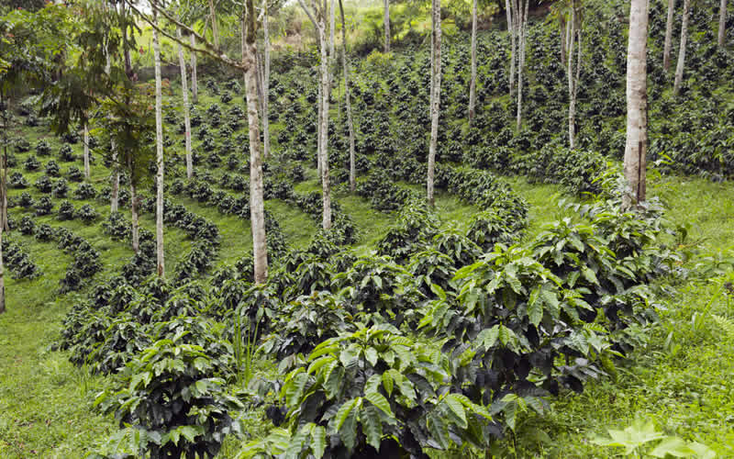
Our Next EBA Practices: Agroforestry
Photo from https://greentumble.com/advantages-and-disadvantages-of-agroforestry/

Slide 23
Agroforestry
Use trees as part of farming
Border around fields
Interspersed throughout fields (“intercropping”)
Native species that retain soil and reduce runoff
Take up space, water, and nutrients
Windbreak & soil / water retention, local cooling
Net effect is ambiguous! Results vary.

Slide 24
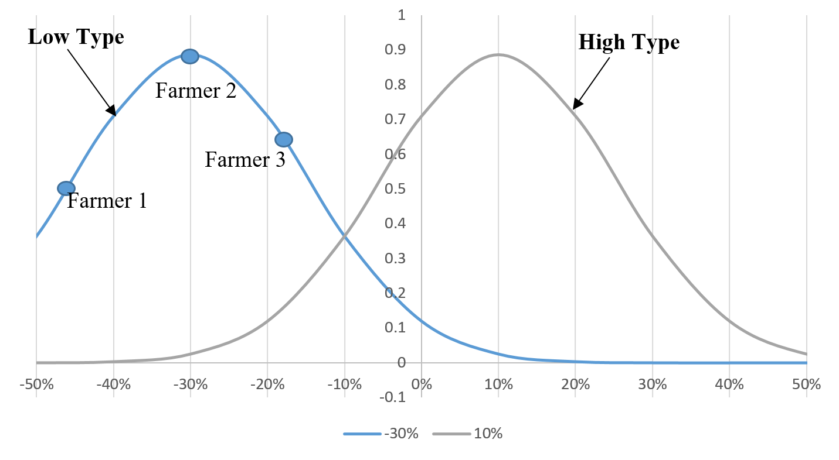
Uncertain Mean Effect *AND* Uncertain Idiosyncratic Effect!

Slide 25
Conservation Periods 5A & 5B: Uncertain but Correlated Direct Effect
EBA practice: border agroforestry
Mean effect on everyone’s farming income is either -30% or +10%
Each person’s personal effect is that mean effect plus/minus a random number
Cost to adopt: 1,000
Government payment to adopt: 1,500
Ecosystem service benefits: 5% times number of adopters
Earnings if adopt:
Earnings = Farming Value * (1 + # adopters * 5%)
+/– Farming Value * (Unknown Yield Effect) + 500
Earnings if don’t adopt:
Earnings = Farming Value * (1 + # adopters * 5%)
₼
₼
₼

Slide 26
Conservation Periods 6A & 6B: Pilot Bonus
EBA practice: intercropped agroforestry
Mean effect on everyone’s farming income is either -30% or +10%
Each person’s personal effect is that mean effect plus/minus a random number
Cost to adopt: 1,000
Government payment to adopt: 1,500
Ecosystem service benefits: 5% times number of adopters
Earnings if adopt:
Earnings = Farming Value * (1 + # adopters * 5%) +/– Farming Value * (Unknown Yield Effect) + 500 (or +1000 in the first period)
Earnings if don’t adopt:
Earnings = Farming Value * (1 + # adopters * 5%)
₼
₼
₼
₼

Slide 27
Class Discussion
Why did you make the adoption choices you made?
How do individuals make decisions when outcomes are uncertain? How should policymakers make decisions when policies’ impacts are uncertain?
If you wanted farmers in your country to undertake a new practice for EBA, what policies would you favor?
What about the money that funds these PES programs? Where does it come from? What effects does it probably have on inequality?

