Slide 1
Extension Presentations for the New Extension Professional
Dr. Shannon L. Ferrell
Assistant Professor – Agricultural Law
OSU Department of Agricultural Economics

Slide 2
Our Topics Today
The role of in-person presentations
Preparing for the event
Crafting presentations for impact
Q&A

Slide 3
HYPOCRISY DISCLAIMER
I’M WORKING ON IT

Slide 4
The Role of In-Person Presentations

Slide 5
The Role of In-Person Presentations
In order to aid in diffusing among the people of the United States useful and practical information on subjects relating to agriculture... and to encourage the application of the same... agricultural extension work [] shall be carried on in cooperation with the United States Department of Agriculture...
Smith-Lever Act, 7 U.S.C. §341

Slide 6
Preparing for the Event
Assessing
the event
the audience
the site
Promotion

Slide 7
Preparing for the Event: Event Assessment
Immediately establish the Five W’s
Who (more important than you think)
What (and are you right for it)
When
Where
WHY???
Part of ongoing program?
Continuing education credits?

Slide 8
Preparing for the Event: Audience Assessment
Knowledge – be aware of information
Comprehension – identify relationships
Application – apply principles
Analysis – break down information
Synthesis – make something new
Evaluation – judge worth of content

Slide 9
Preparing for the Event Audience Assessment
Interview event organizer
Interview / survey audience members
Consult other extension professionals

Slide 10
Preparing for the Event: Site Assessment
Has venue been set? If so:
A/V capabilities
Acoustics
Environment
If not:
Level of interaction?
Logistics?
The forgotten variable: socializing

Slide 11
Preparing for the Event: Promotion
Have the following “in the can” for EACH topic area
News releases
Flyers
Biographic sketches
Introductions
...but modify to specific event – build rapport
Calendar follow-up contacts

Slide 12
Crafting Presentations for Impact

Slide 13
Conquering the Fear
41% of Americans list public speaking as their FOREMOST fear
Study it
Be prepared
Do it
Slowly build your audience
Record yourself and review with friends
...then do it, and do it some more, and keep doing it...

Slide 14
Crafting Presentations for Impact: Establishing Content
Review your Five W’s and audience data
Confirm that your information is CURRENT!
Aim for the “modal” level of your audience
Have resources available to help those both below and above the mode
Insofar as is feasible, assiduously endeavor to truncate excessively loquacious disciplinary idiom

Slide 15
Crafting Presentations for Impact: The Introduction
It starts WAAAAY before you approach the stage
Use it for what it’s meant
Pre-load your credibility and rapport
Highlight traits that link you to audience
Underscore experience on topic BUT
Don’t bludgeon them with it... NO CV READING

Slide 16
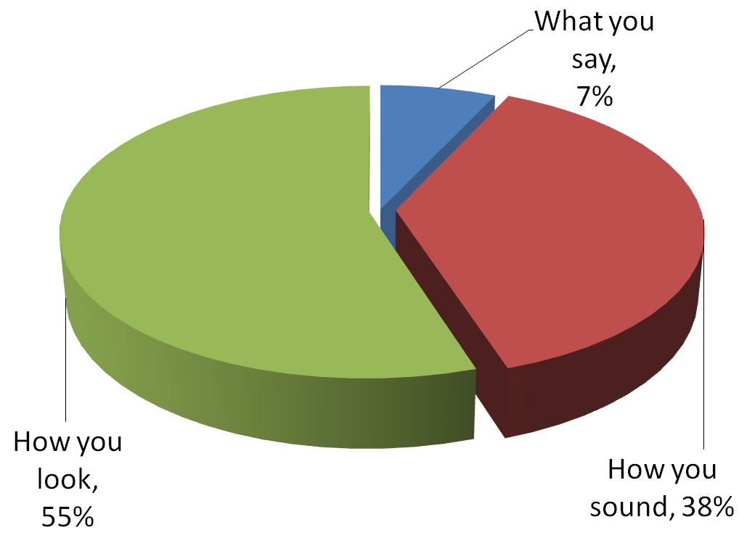
Crafting Presentations for Impact: Breaking Down the Delivery
Notes:
Talk your Way to the Top, p. 17, adapted from Non-Verbal Communication by Albert Mehrabian

Slide 17
Crafting Presentations for Impact: How You Look
Target your appearance to fit
The audience (one notch up)
The environment
Your body language matters
Posture
Stance / gestures
Expression
Range

Slide 18
Crafting Presentations for Impact: How You Look
Public: beyond 12 feet
Social: 4 feet – 12 feet
Personal: 18 inches – 4 feet
Intimate : Touch – 18 inches

Slide 19
Crafting Presentations for Impact: How You Sound
It’s hard to diffuse and encourage if they can’t hear you
Check to confirm audience can hear
Check and use audio equipment
Project – “from the diaphragm”
Have water available
Confident tone
Speed kills!

Slide 20
Crafting Presentations for Impact: What You Say
Have notes available for emergencies – not as a crutch
Strive for the tone of a conversation
Smith-Lever said “encourage application” but it didn’t say HOW to apply
Pro’s and con’s
ALTERNATIVES and CONSEQUENCES

Slide 21
Crafting Presentations for Impact: Visuals
Beware the “PowerPoint as Document”
Provide outline or handout after meeting
Let audience know about handout
Use 24 pt or greater font
Avoid complete sentences
Use contrasting colors

Slide 22
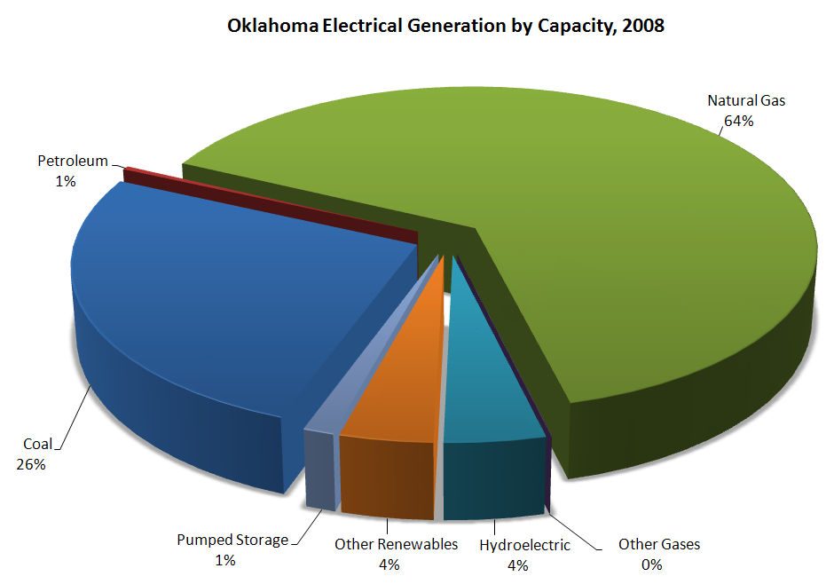
Crafting Presentations for Impact: Visuals
Pie charts: visualizing proportions of a whole

Slide 23
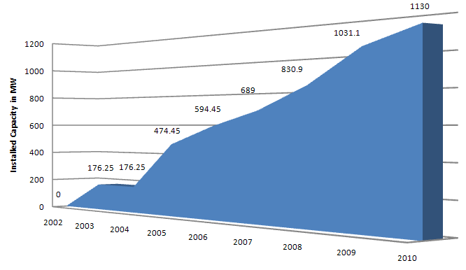
Crafting Presentations for Impact: Visuals
Line charts: visualizing trends over time

Slide 24
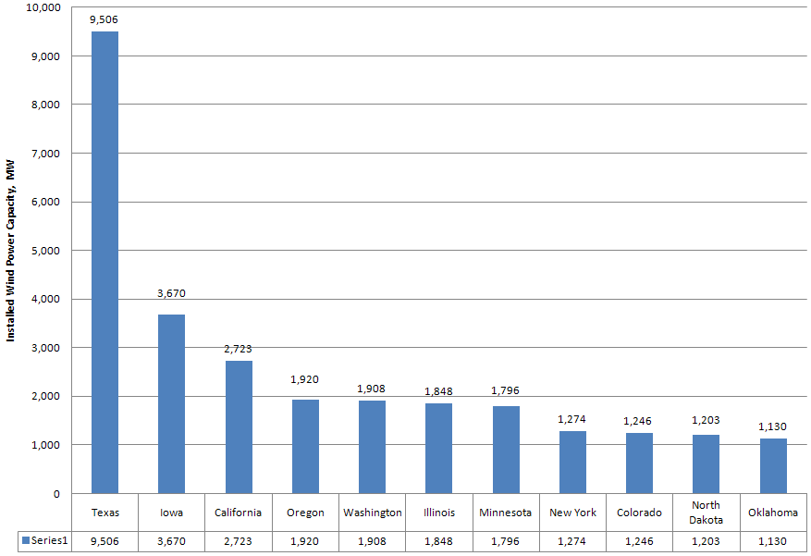
Crafting Presentations for Impact: Visuals
Bar charts: visualizing comparisons

Slide 25
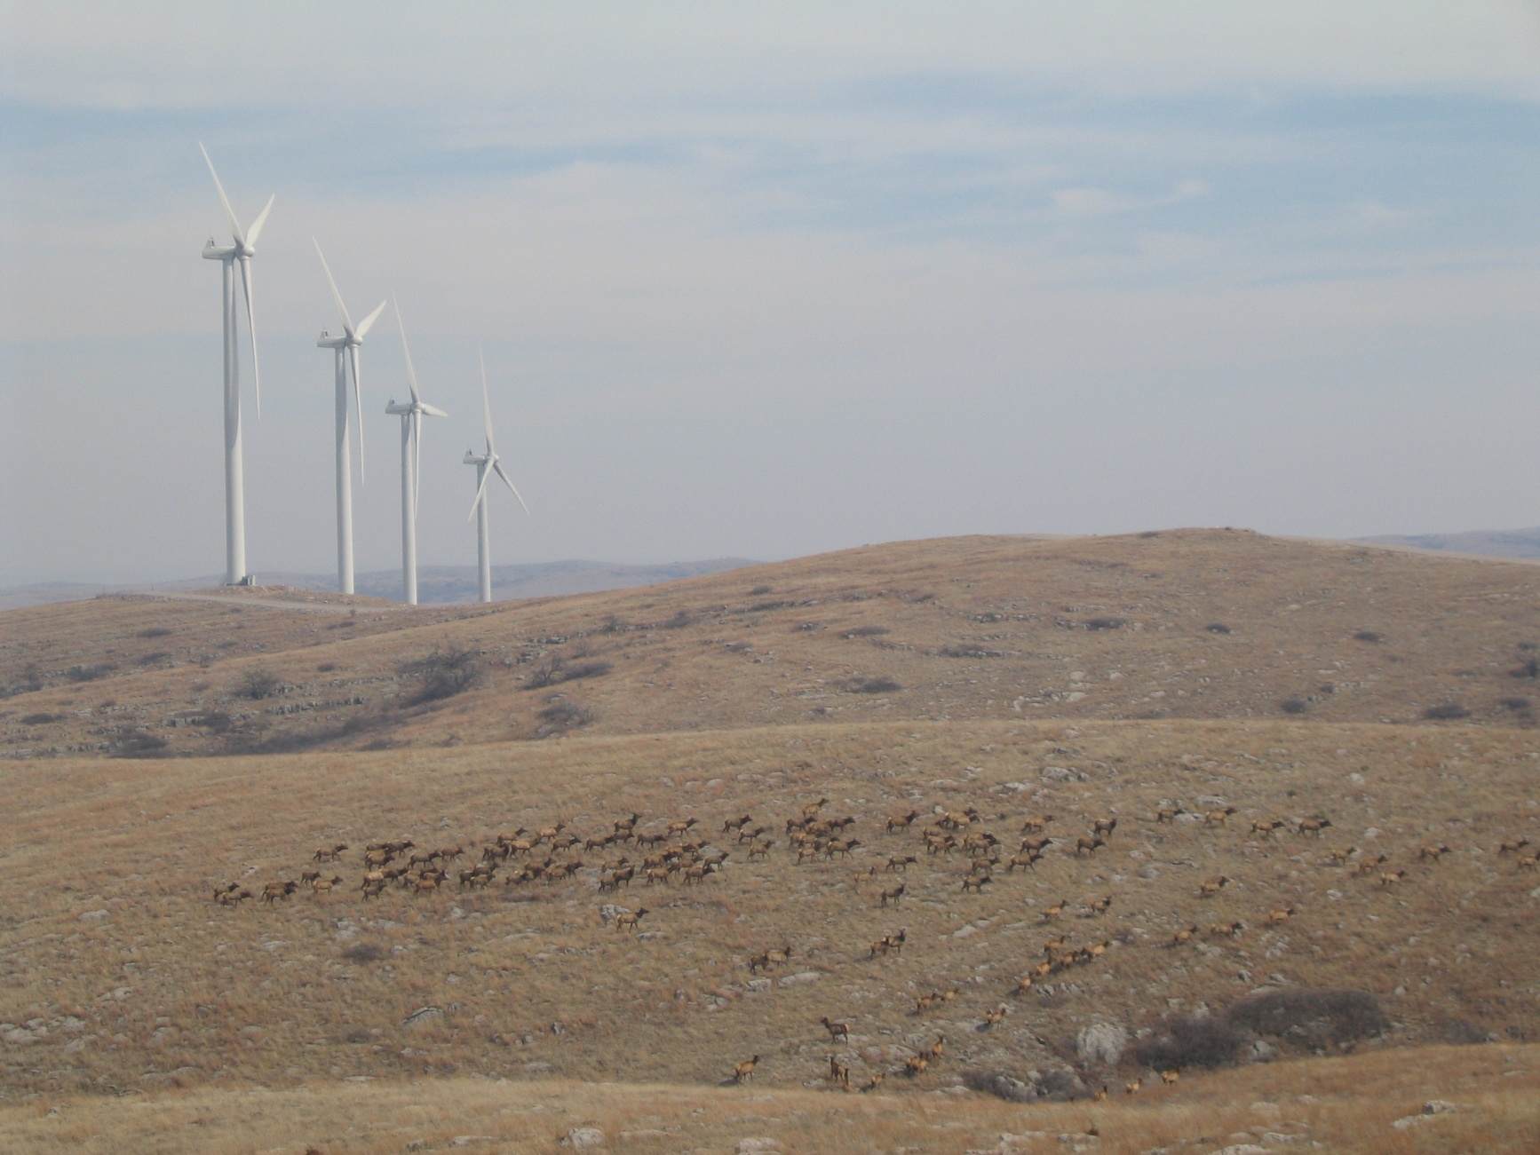
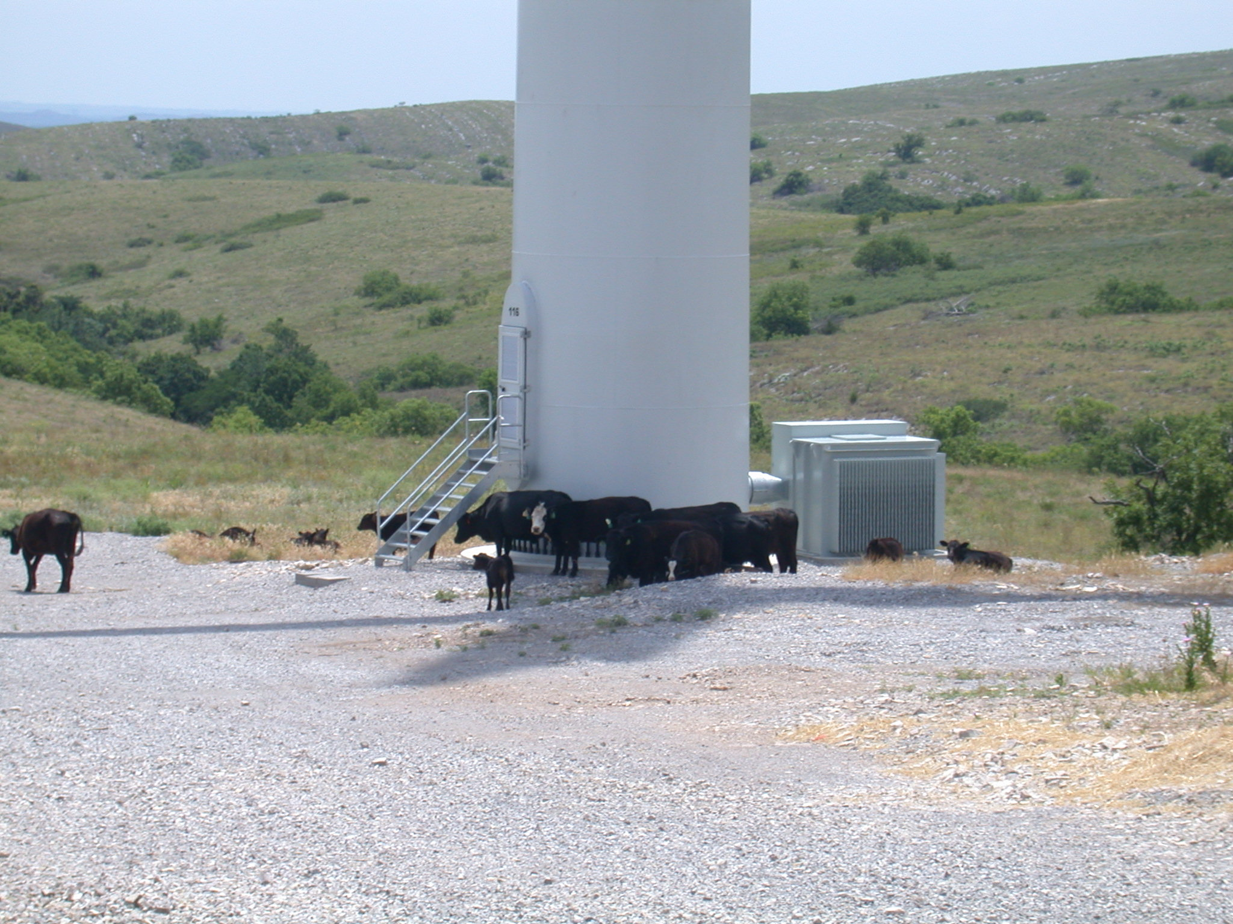
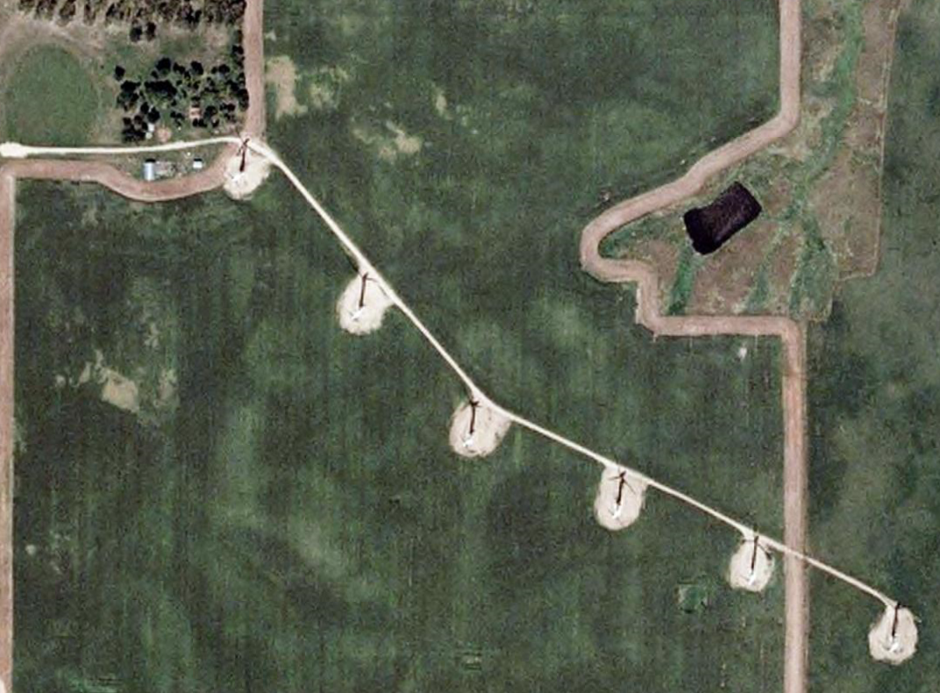
Crafting Presentations for Impact: Visuals

Slide 26
Q&A

Slide 27
Questions and Answers
Establish Q&A “policy” early
Size matters
Smaller groups: integrated Q&A OK
Larger groups: move Q&A to end
The value of Question Cards
Bridge Q&A to continuing programming

Slide 28
Questions and Answers
Establish Q&A “policy” early
Size matters
Smaller groups: integrated Q&A OK
Larger groups: move Q&A to end
The value of Question Cards
Bridge Q&A to continuing programming

Slide 29
Questions and Answers
Got any?

Slide 30
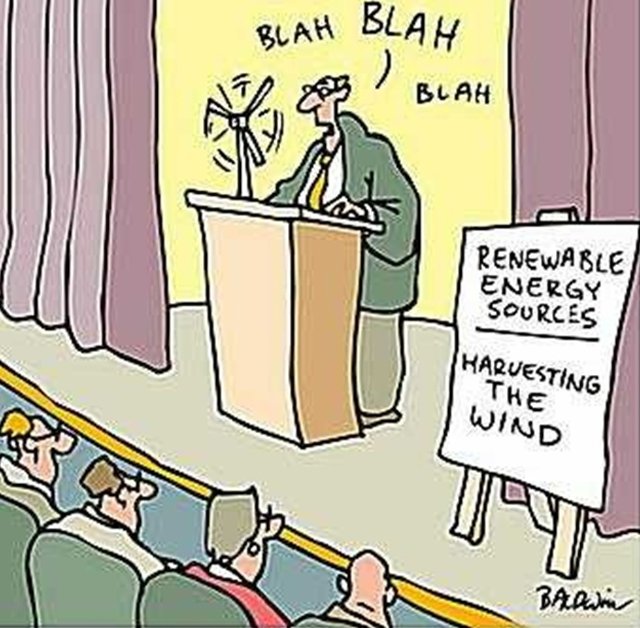
Thanks!
Shannon L. Ferrell,
OSU Department of Agricultural Economics
shannon.l.ferrell@okstate.edu

